Slide 1

Groomify
Name: Damien Tan Lek Khee CU ID: 12672844
Supervisor: Kavitha Thamadharan

Slide 2

INTRODUCTION
- Pet grooming booking app
- Recommend groomers to users
- Users could schedule appointments
- Groomers could manage appointments

Slide 3

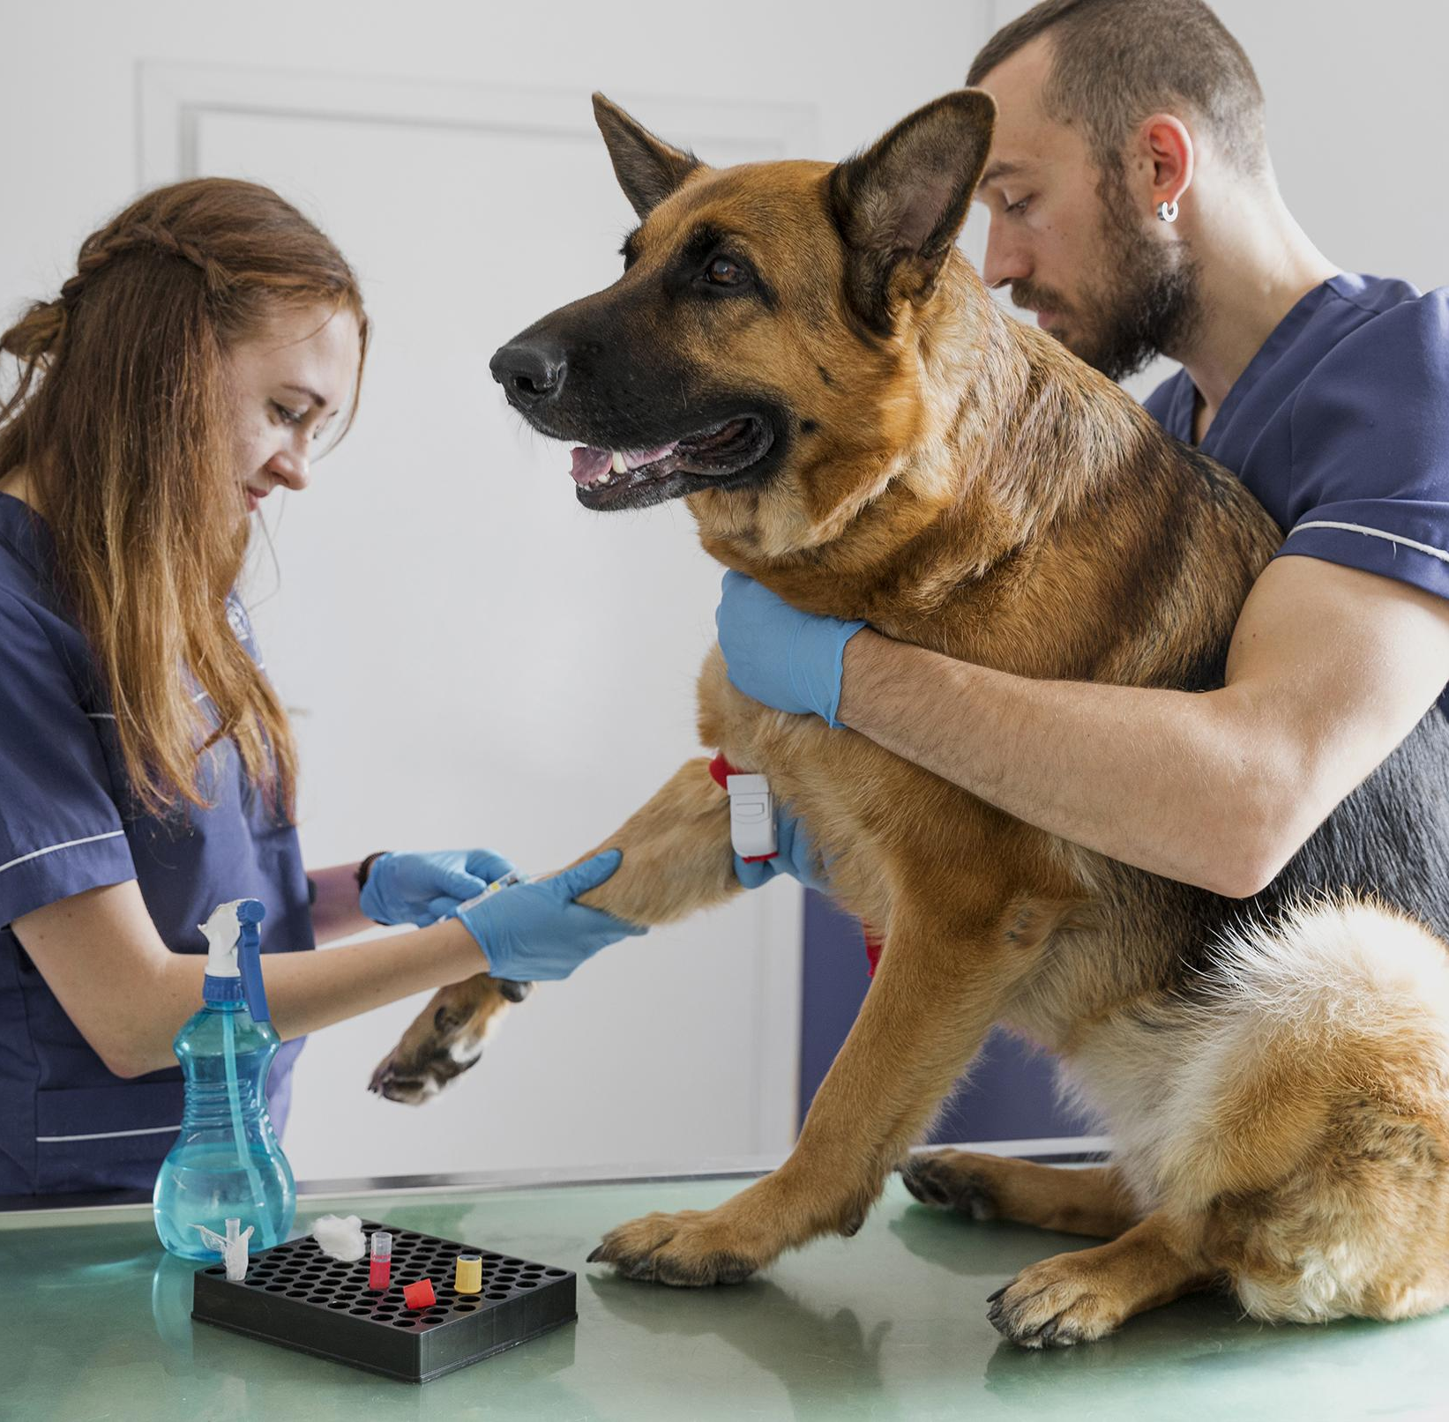
Inefficient Booking Methods
Confidence in Grooming Services
Problem Statement
- Time-consuming to research
- Inefficient communications with pet groomers
- Lack of confidence in pet grooming services

Slide 4
Able to track appointments easily
Create a mobile app to schedule online appointments
Problem Objectives

Slide 5
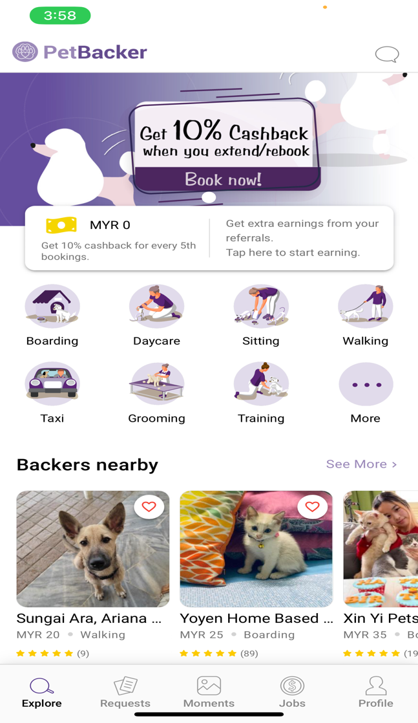
Literature Review
Existing System
PetBacker

Slide 6

Project Methodology
Structured development methodology
Structured & sequential development process
Milestone-based Progress Monitoring
Effective tracking of project’s advancement
Focused goal achievement
Focused on achieving specific goals

Slide 7
Use Case Diagram

Slide 8
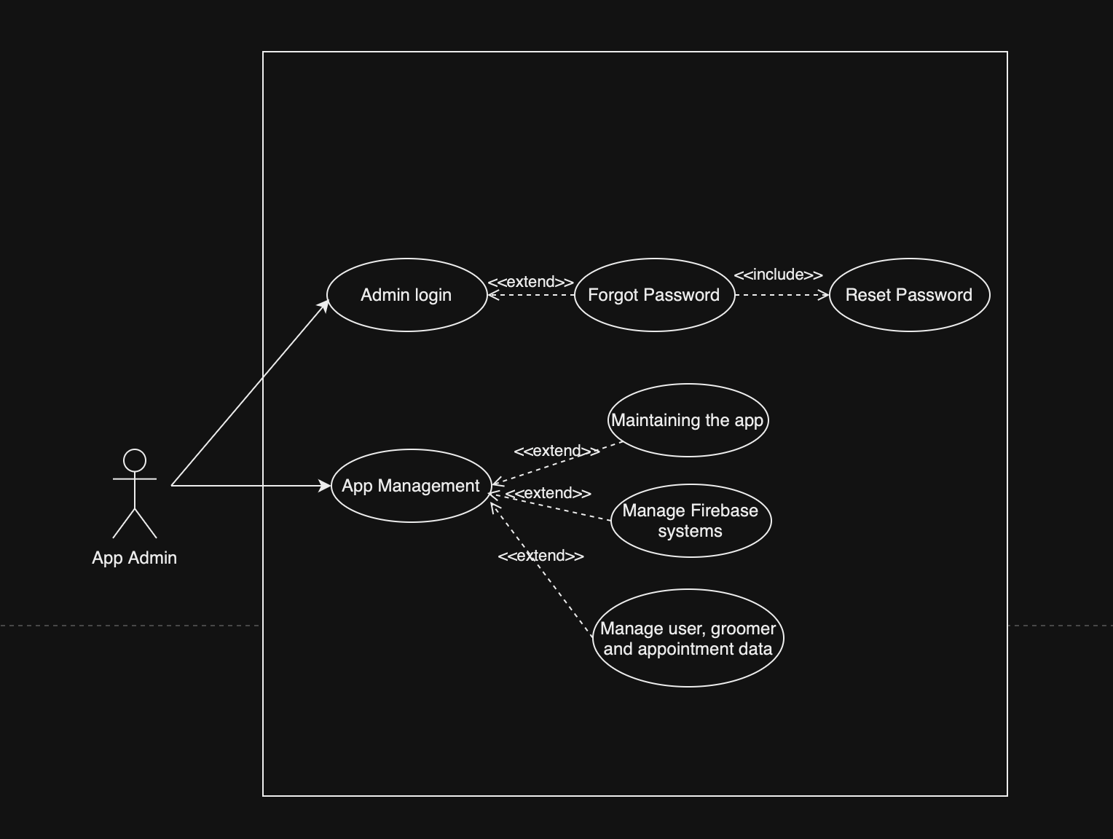
Admin

Slide 9
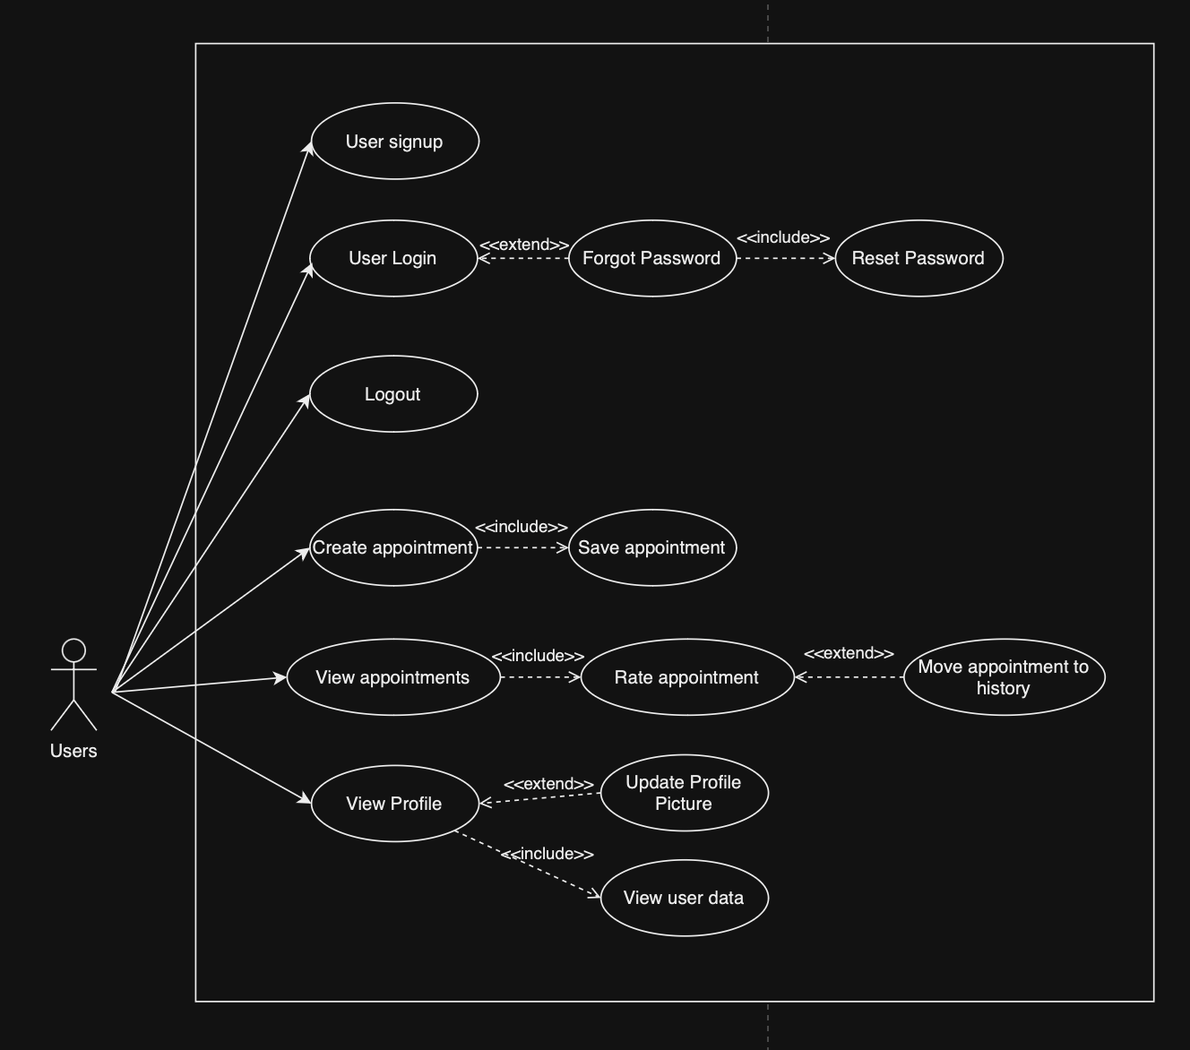
User

Slide 10
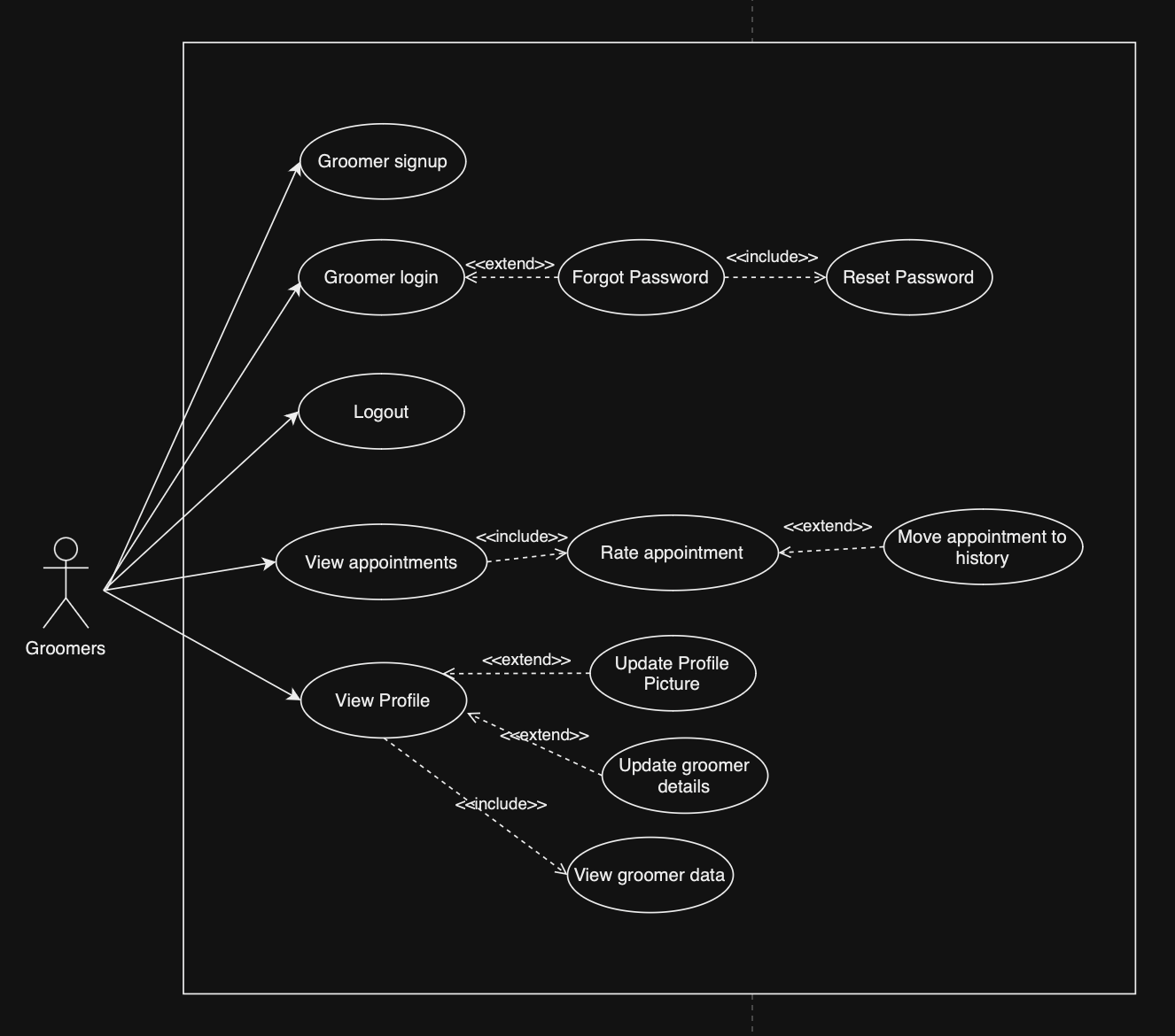
Groomers

Slide 11
Entity Relationship Diagram

Slide 12
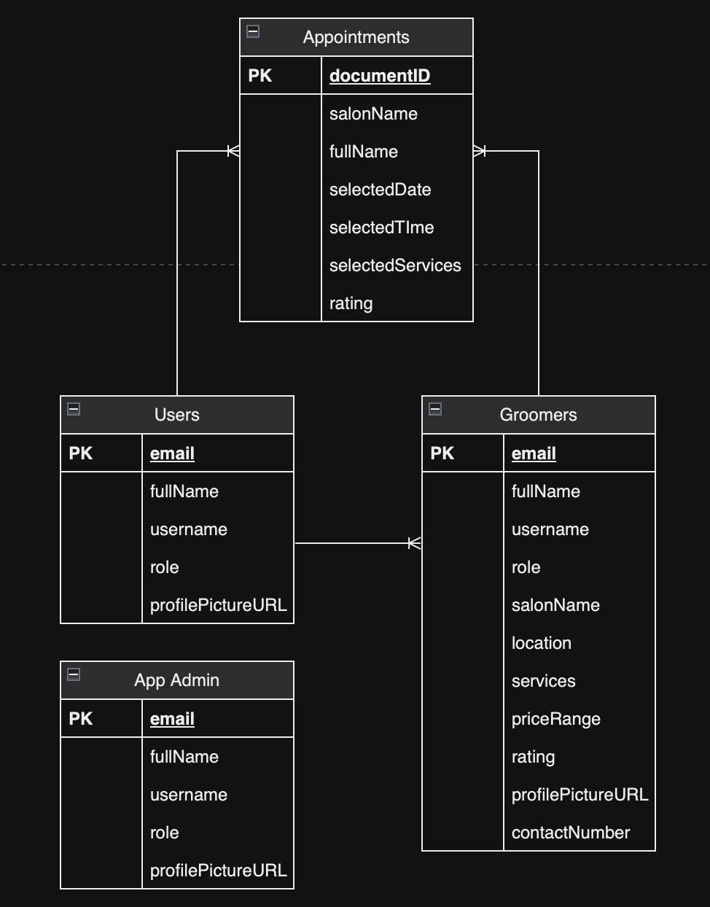

Slide 13
Flowchart
Link: ../Developer/GitHub Repo/Groomify/flowchart.docx

Slide 14
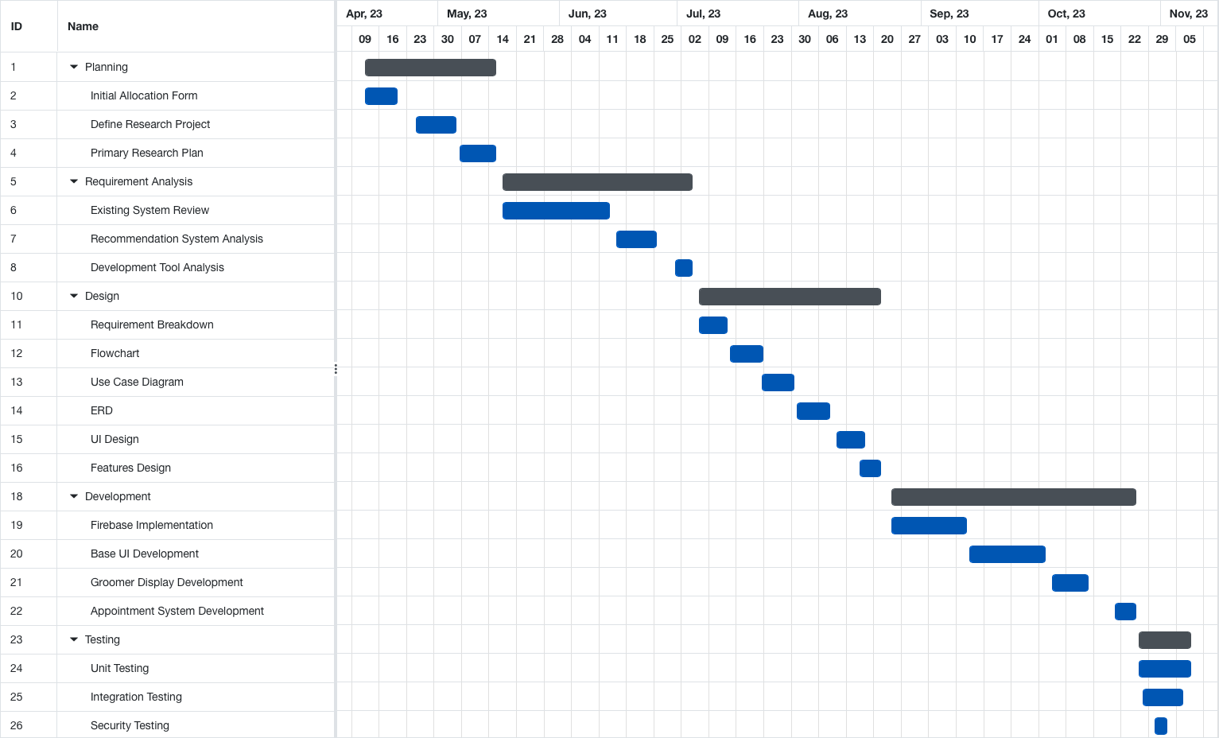
Gantt Chart

Slide 15
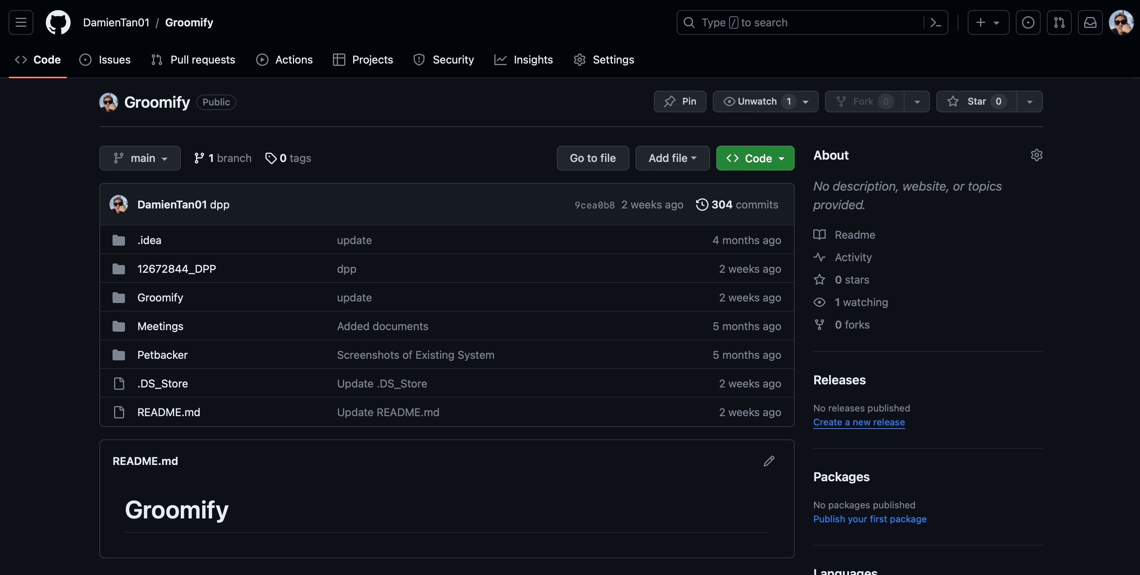
Version Control

Slide 16
Tools Used
01
02
03
Firebase
Android Studio
Figma
- Data storage
- Authentication
- App development
- Prototype design

Slide 17

Prototype Demo

Slide 18
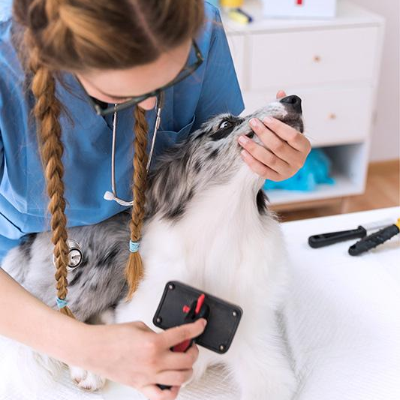
Result

Slide 19
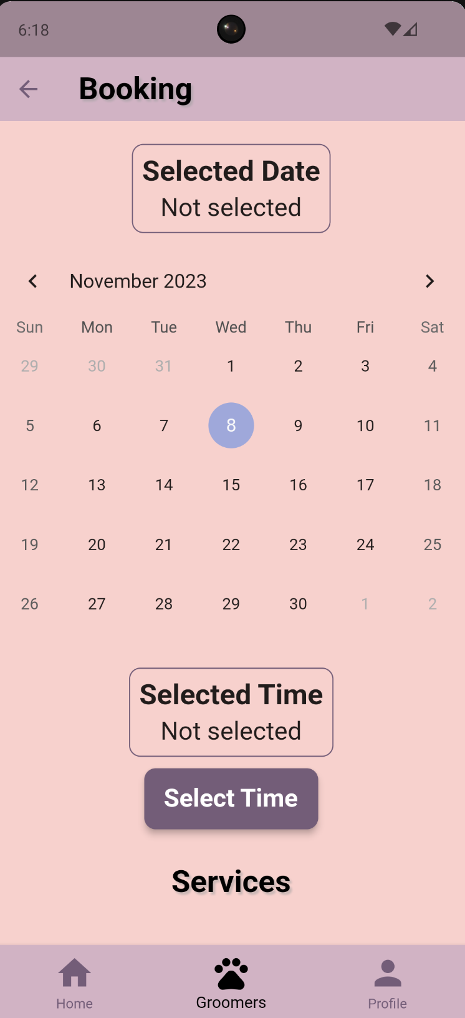
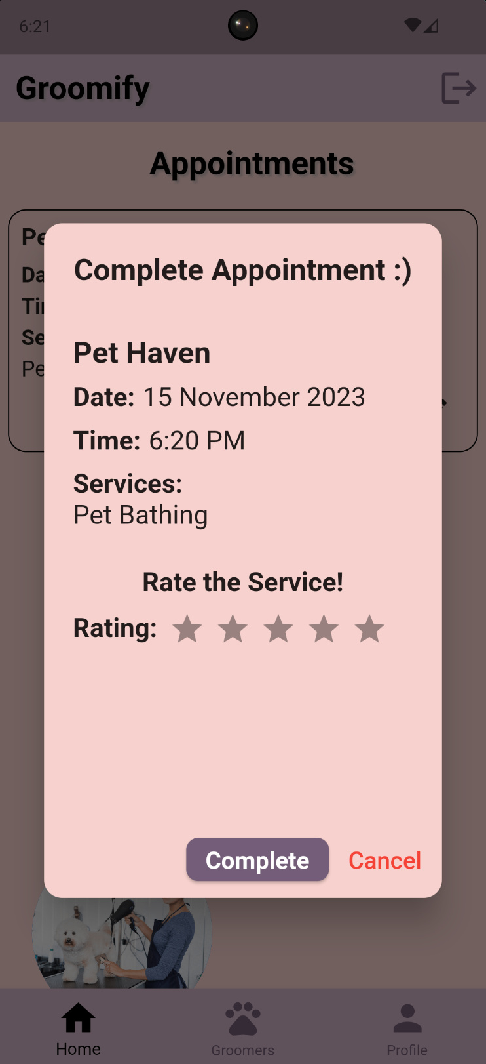
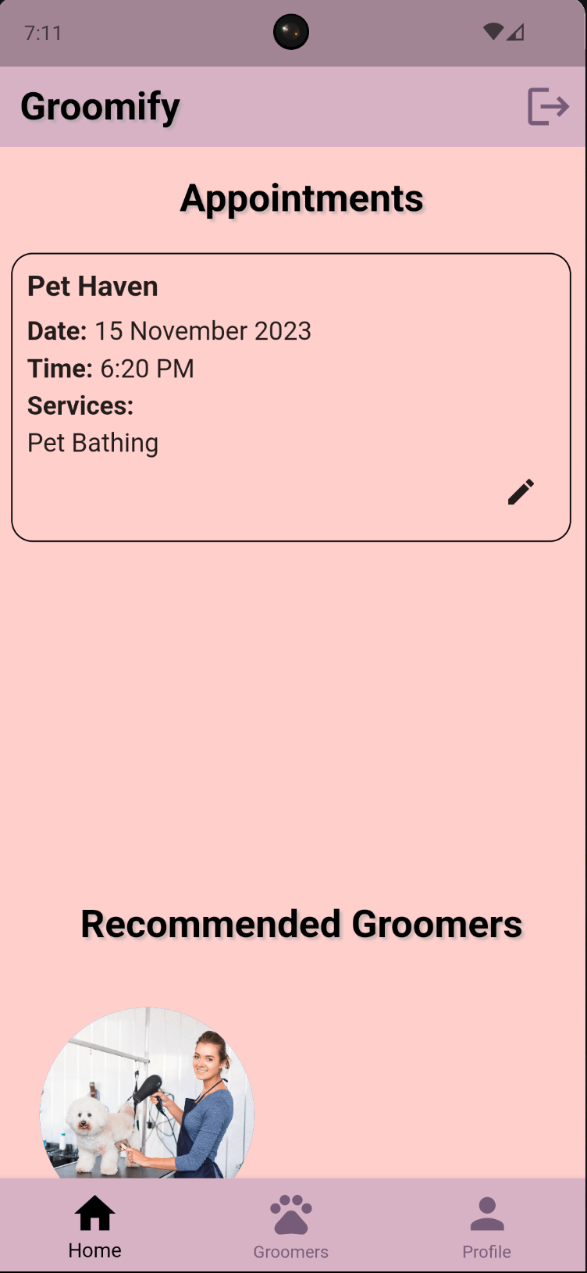

Slide 20

Discussion

Slide 21
Limitations
Network-Related Problems
Sluggish data loads in areas with erratic or slow network connectivity.
Potential user irritation and reduced interaction with the app.
Absence of Comments Section
Lack of a platform for users to offer criticism, share experiences, and ask questions within the app.
Diminished user interaction and engagement.
No Location API
Difficulty for users to find the nearest groomer in their area.
Impaired user experience, especially for those seeking immediate grooming services.
No Online Payment
Users forced to seek alternate payment methods.
Decreased convenience and potential security concerns for financial transactions.
Inability to Edit and Cancel Appointments
Users frustrated by the inability to make timely adjustments to their grooming schedules.
Lack of flexibility in meeting dynamic scheduling demands.
Lack of Appointment History Viewing
Users unable to access past appointment records and grooming history.
Hindered ability to ensure comprehensive pet care and maintain grooming records.

Slide 22
Enhancements
Addressing Network Limitations
Implementing a more effective data handling system.
Improving offline functionality, local caching, and data transfer protocols.
Adding Comments Section
Enabling users to share experiences, opinions, and questions within the app.
Providing a forum for constructive criticism and continuous improvement.
Integration of Location API
Facilitating users in finding the closest grooming salons.
Streamlining the appointment scheduling process with up-to-date location information.
Online Payment Feature
Simplifying the booking and payment process within the app.
Ensuring secure and convenient financial transactions for users.
Edit and Cancel Appointments
Allowing users to adjust grooming schedules as needed.
Enhancing overall user experience and satisfaction through dynamic scheduling.
Appointment History Section
Providing users with a thorough overview of their pet's grooming history.
Supporting a more planned and knowledgeable approach to pet care.

Slide 23

Reflection

Slide 24
Challenges Faced
Academic Overload
Overseeing additional academic courses alongside the Groomify project.
Demands of effective time management and prioritization to balance coursework and project work.
Dynamic Nature of Software Development
Continuous emergence of new challenges in the development process.
Resemblance to the game of whack-a-mole, with one bug fixed leading to the discovery of another.
Emphasis on adaptability, resilience, and constant attention to detail.
Testing Struggles
Testing proving to be a challenging and time-consuming aspect of development.
Recognition of the importance of thorough testing for functionality, security, and user experience.
Acknowledgment that rushing through testing can lead to undiscovered bugs and user dissatisfaction.

Slide 25
Challenges Overcomed
Effective Time Management
Prioritization and disciplined schedule to balance project work and academic obligations.
Recognition of the importance of seeking help when needed.
Adaptability and Resilience
Embracing the dynamic and iterative nature of software development.
Building resilience through constant development, real-time troubleshooting, and attention to detail.
Thorough Testing and Validation
Commitment to comprehensive testing despite its time-consuming nature.
Acknowledgment of the extension of the project timeline for the sake of producing a reliable and user-friendly application.
Understanding the critical role of testing in ensuring functionality, security, and a positive user experience.

Slide 26

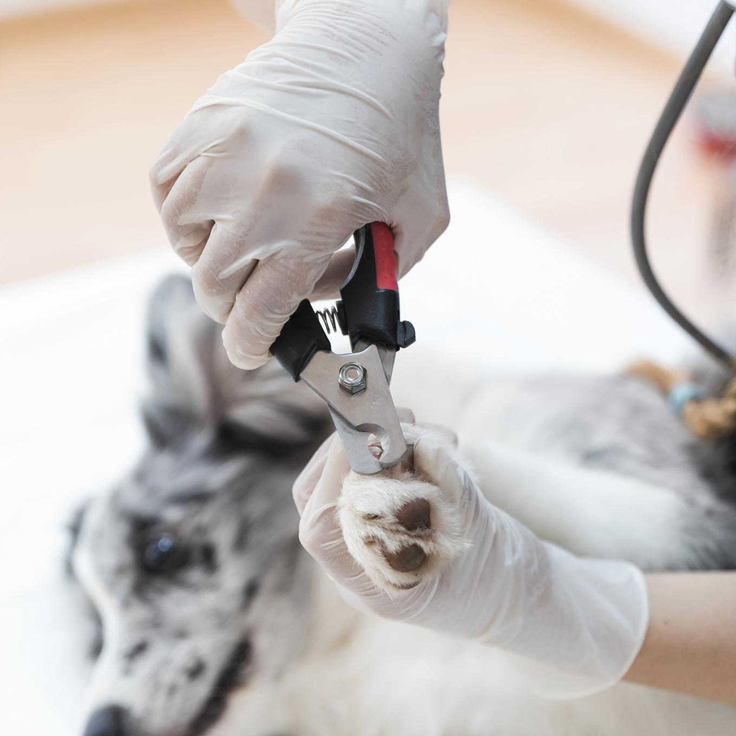
Conclusion

Slide 27
Thank
You

